Slide 1


SAP Full-Stack Developer training
ABAP on HANA, UI5 & Fiori, Analytics with OData
Anubhav Oberoy
Day – 17
Notes:
www.anubhavtrainings.com

Slide 2
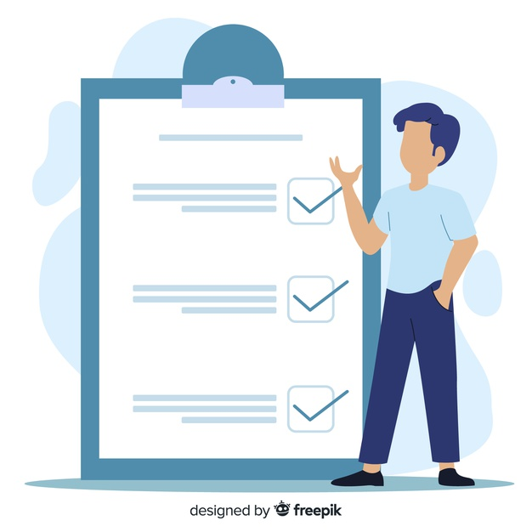
Agenda – Day 17
Introduction to SAC (SAP Analytics Cloud)
Defining Phase of SAC
Business Intelligence
Planning
Predictive (ML)
Application Designer
Describing On-Premise vs Cloud
What is SAP Cloud Platform
Modelling in SAC
Types of Model
Define Concept of Account Dimension & Hierarchy
--Break--
Business Intelligence (BI) Feature
BI Model
Creating BI Dashboard
Describing Smart Assist Features
Notes:
www.anubhavtrainings.com

Slide 3
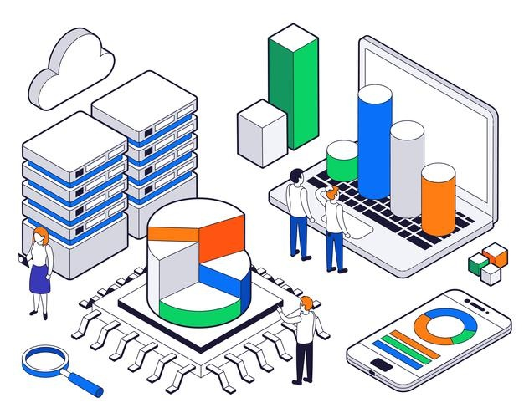
What is SAC ?
SAP Analytics Cloud is a software-as-a-service (SaaS) connecting your people, data, and ideas from multiple sources to enable fast and confident decision making. It allows users to discover, visualize, plan, and predict, all in one place.
SAP Analytics Cloud enables the intelligent enterprise by providing everyone with the insights to make confident decisions and take action in the moment.
Analytics feature in SAP tool depends on data algorithms, programming, and operations research to get data insight and to help the business in finding meaningful information from data coming from multiple data sources. This information is used by all enterprises to perform the business planning and forecasting.
Notes:
www.anubhavtrainings.com

Slide 4
Defining Phases of SAC
Four Phases of SAP Analytics Cloud
Business Intelligence
Planning
Predictive (ML)
Application Designer
Analytic Designer
Planning with SAC
Predictive Analytics With ML
Building models and BI Stories
Learn Writing Specifications
Live Data Connections
Understand planning jargons
Hardware Innovation
Notes:
www.anubhavtrainings.com

Slide 5
On-Premise vs Cloud
01
Software is consumed as a Service (SaaS).
Hardware to be purchased Networking to be setup.
01
02
No installation required in our company.
License to be bought by paying a lump-sum and licensing cost.
02
On-premise
No hardware, no networking, no need to hire consultants to manage the users.
Cloud
03
Software Innovation
Hire professionals to maintain the system and health of the solution.
03
Complete software is managed by Vendor including patches and upgrades
04
Upgrade and new patches on customer to apply.
Hardware Innovation
04
Notes:
www.anubhavtrainings.com

Slide 6

SAP Cloud Platform
SAP Cloud Platform is a platform as a service which provides support for developing applications in the cloud, it offers all what teams need for developing End-to-End enterprise apps which runs natively on cloud like DB, Programming, Monitoring.
It is available in 2 modes
Neo (Obsolete)
CF – Cloud Foundry ( IaaS – AWS, Google, Azure, Alibaba)
Data Center OR region: cloud vendors to achieve scalability, elasticity and compliance, they have data kept at different locations in the world which is knowns as Data centers.
SAP Cloud Platform Offerings
https://discovery-center.cloud.sap/serviceCatalog/sap-analytics-cloud
SAP Analytics Cloud is a Software as a Service offered by SAP which is hosted on SAP Cloud Platform Cloud Foundry Environment powered by AWS on 3 regions.
Notes:
www.anubhavtrainings.com

Slide 7

Set up SAC Trial Account
Create your SAC (SAP Analytic Cloud) Trial Account ( 90 Days )
https://saphanajourney.com/sap-analytics-cloud/trial/
Software Innovation
Hardware Innovation
Notes:
www.anubhavtrainings.com

Slide 8
Modelling
Model is the foundation which is built using data or connection in SAC for building stories.
Following Steps for why we need Models:
01
Data Wrangling and Cleansing .
02
Blending of Data.
03
Hierarchy
Software Innovation
04
Adding new dimensions and measures.
05
To perform aggregations on measures.
Notes:
www.anubhavtrainings.com

Slide 9
Types of Model
Embedded vs Public
Acquired vs Live
Embedded Models are only used in one story.
Public models can be used in Multiple stories – Reusable.
All the data is stored inside SAC are known as Acquired Data Model.
Live – Only the skeleton of the data is kept in SAC, the data and security is with source system.
01
Analytic vs Planning
Analytics models are used in BI Stories, and Planning models are using in planning scenario, Most of the models are Analytic Models = Account Dimension → Grouping of measure.
A planning model has following mandatory – Account, Category(version), Time, Org.
03
02
Notes:
www.anubhavtrainings.com

Slide 10
Account Dimension & Hierarchy
Account Dimension:
All our measures combining called Account Dimension.
Grouping of all the KPI and also financials it gives Sign (+ve, -ve)
Account Dimension in planning also have version.Category = Actual, Forecast, Budget
Hierarchy:
Representation of our data in TREE Structure, Better visualization to our data
02
Level based
Hierarchy
Parent-Child
Hierarchy
01
Notes:
www.anubhavtrainings.com

Slide 11

Break
Notes:
www.anubhavtrainings.com

Slide 12
Business Intelligence
BI – Business Intelligence
BI comprises the strategies and technologies used by enterprises for data analysis on historic data and present data for finding patterns and taking future decisions.
Bi is now leveraging machine learning which is field of AI to take confident decisions.
Requirement Collection
Access Data
Prepare Modeling
Visualize Building Story
Predict
Share
Software Innovation
The SAP Analytics Cloud solution combines BI, augmented and predictive analytics, and planning capabilities into one cloud environment. As the analytics layer of SAP's Business Technology Platform, it supports advanced analytics enterprise-wide.
Notes:
www.anubhavtrainings.com

Slide 13
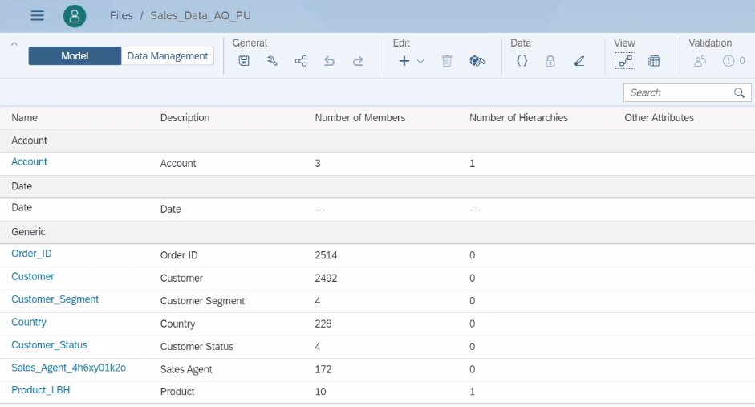
Creating Model for BI Story (Analytic Model)
Click on Create Model
Get Data Source
HOME
Create Model
Notes:
www.anubhavtrainings.com

Slide 14
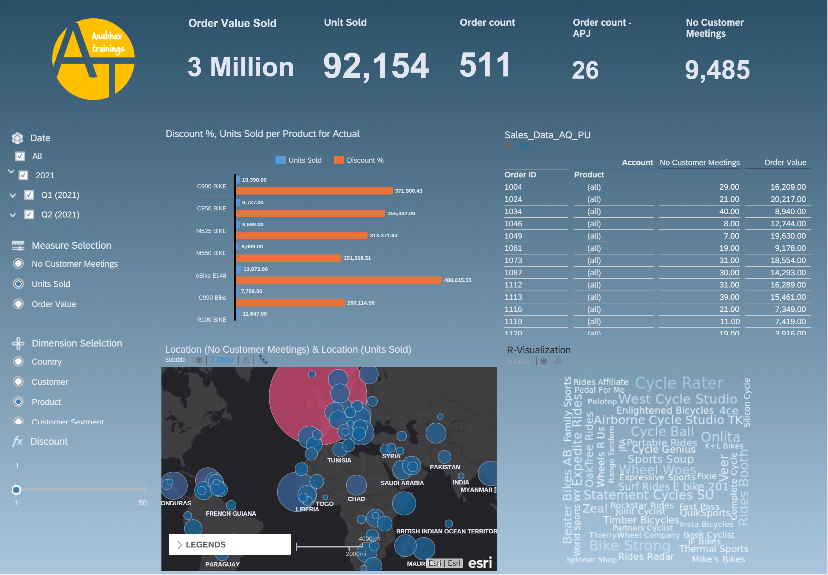
BI Scenario for Creating Dashboard
Exercise :
BI Scenario
Notes:
www.anubhavtrainings.com

Slide 15
Smart Assist Feature
Smart Insight
Its simple, easy to use machine learning to find out most important key influencers contributing to a measure. We will also be able to drill down to these influencers.
Time Series Forecasting
Depending on past data of a measure based on time (dimension) we can find the expected value of a measure w.r.t time and deviation. SAC usage 2 in-built algorithms to predict forecast
Triple Smoothing
Linear Forecast
Smart Discovery
It offers a complete machine learning suite(robot) to build ENTIRE dashboard automatically with just one click, what we need to specify is the measure which we want to use to be in focus. It will also find the anomalies and unexpected hidden patterns in the data.
Smart Grouping
1
Search to Insight
Allows us to CLUSTER data depending in groups we choose, suppose we want to segmentize the data points in multiple groups. E.g. group customers based on their ability to pay the pending bills, group students of a class in merit, demerit and mediocre.
Allows users to use NLP (Natural Language) to command system and system can convert NL using NLP capability of machine learning and present the outputs to the user.
2
3
4
5
Notes:
www.anubhavtrainings.com

Slide 16

End of Day 17
Notes:
www.anubhavtrainings.com

Slide 17

Questions
Notes:
www.anubhavtrainings.com

Slide 18

Anubhav Oberoy
Notes:
www.anubhavtrainings.com

Slide 19


We’re committed to empower you to be
Most Desirable Resource
through powerful training solutions.
We build the workforce of the future.
250+
Corporate Clients
30,000+
Learners Trained
25000+
Learners Placed
FREE WEBINARS
Sign up for free webinars with industry experts every fortnight!
Enroll Now!
Contact us today!
https://anubhavtrainings.com/
Notes:
www.anubhavtrainings.com

Slide 20




More from AnubhavTrainings.com
Notes:
www.anubhavtrainings.com

